Slide 1
class specification
Class className
{
// body of the class
}
Class contains date members
Class contains function members also
Name of the user defined class
key word

Slide 2
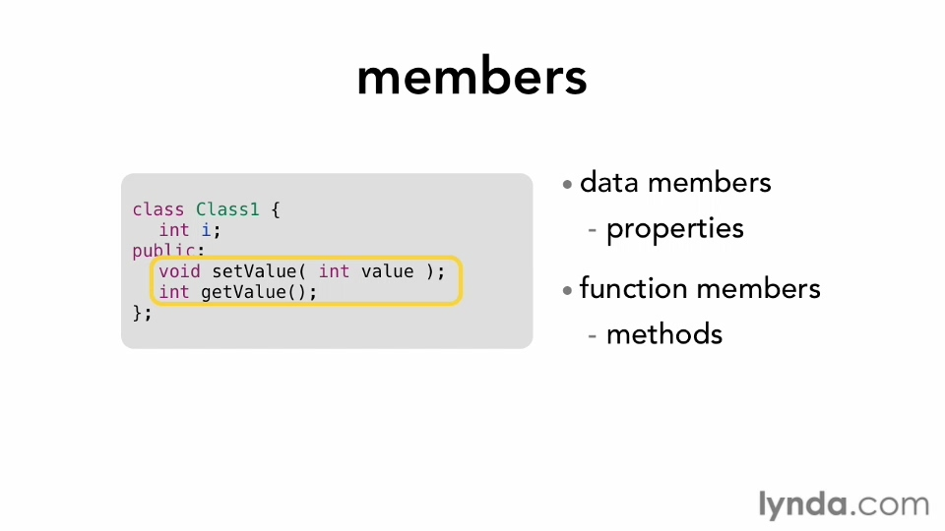

Slide 3
The property of c++ allows association both data members and function members into single unit is called encapsulation.
The members of the class grouped under two sections
Private memebers
Public members
the default class holds members as private
The decalaration private is optinal in the class declaration bcz by default it holds members as private.
A class can have multiple members functions with same name(but differ by arguments)

Slide 4
But the class data members supposed with different name.
In the program more than one class with same name is an error.
Ex:
Class student
{
Int rool_no;
Int total_marks;
Void topper(int exam_marks int project_marks)
Void topper(int score_acdamics int score_activities int score_ngo_activities)
};

Slide 5
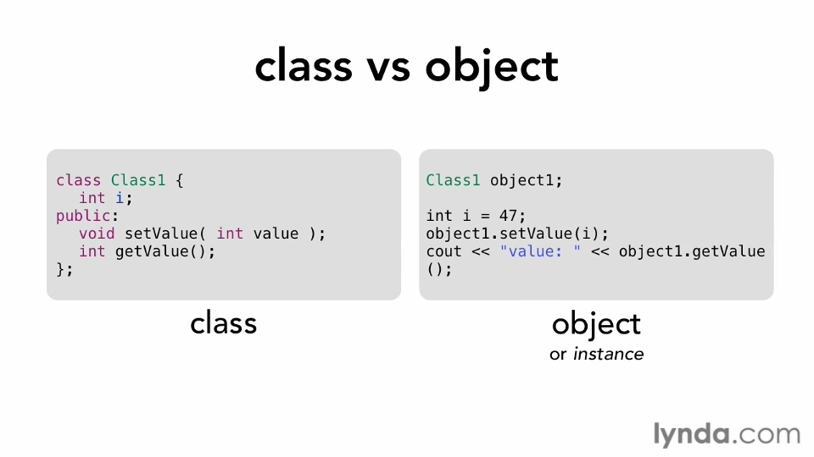

Slide 6
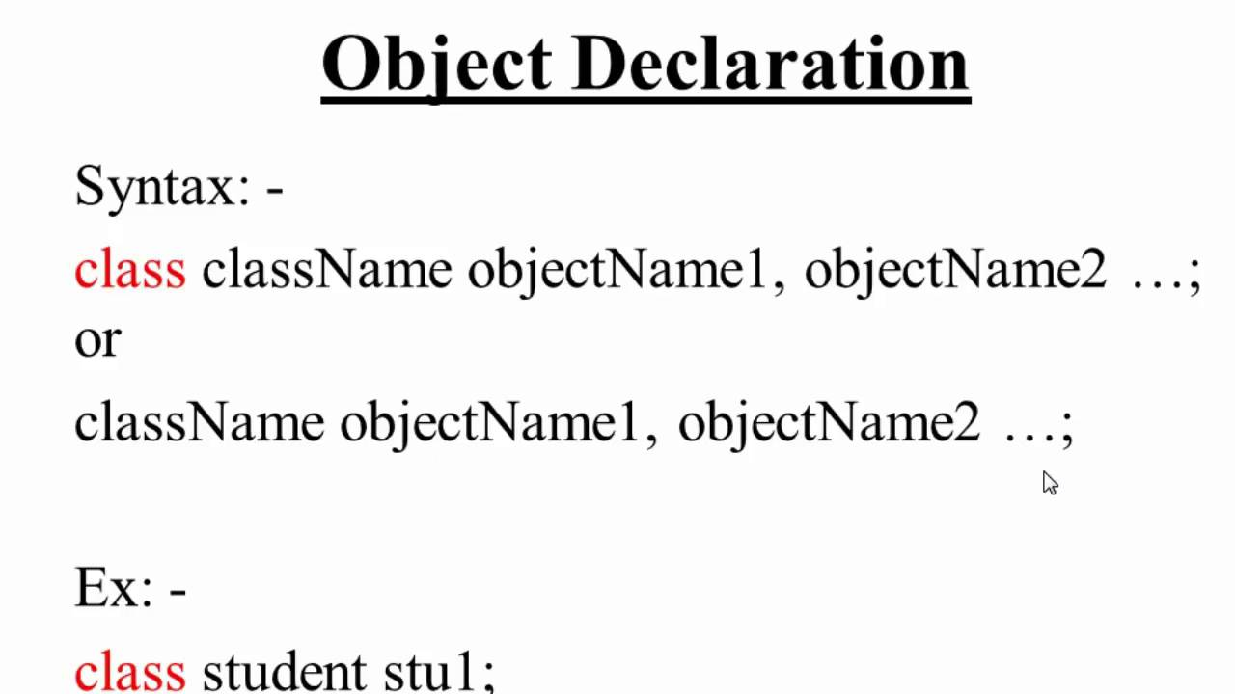
Objects:
The object is instance of the class.
Creation of object of class is called instantiation.
The resources are technical the memory allocated for class members when object is created.

Slide 7
Class student
{
Int rool_no;
Int total_marks;
Void topper(int exam_marks int project_marks)
Void topper(int score_acdamics int score_activities int score_ngo_activities)
} s1,s2,s3,s4;
Object declaration
Class student s1;
(or)
Student s1;
Multiple objects declaration for single class
Class student s1,s2,s3,s4;
(or)
Student s1,s2,s3,s4;

Slide 8
Declaration of member functions
Class classname
{
Private:
int age;
int SetAge(int age1)
{
age=age1;
}
Public:
Int b;
Void myfunc()
{
// body of a function
}
};

Slide 9
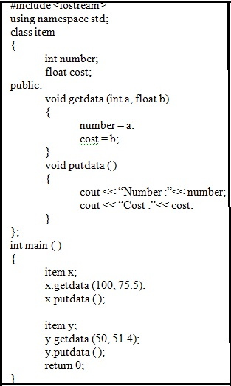
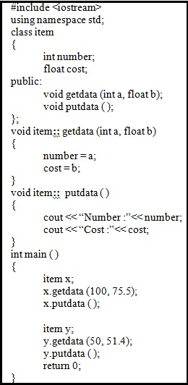

Slide 10
Return Type: A function may return a value. The return_type is the data type of the value the function returns. Some functions perform the desired operations without returning a value. In this case, the return_type is the keyword void.
Function Name: This is the actual name of the function. The function name and the parameter list together constitute the function signature.
Parameters: A parameter is like a placeholder. When a function is invoked, you pass a value to the parameter. This value is referred to as actual parameter or argument. The parameter list refers to the type, order, and number of the parameters of a function. Parameters are optional; that is, a function may contain no parameters.
Function Body: The function body contains a collection of statements that define what the function does.

Slide 11
Defining a Function
return_type function_name( parameter list ) { body of the function }

Slide 12
// function returning the max between two numbers
int max(int num1, int num2)
{
// local variable declaration
int result;
if (num1 > num2)
result = num1;
else
result = num2;
return result;
}

Slide 13
Function Declarations
A function declaration tells the compiler about a function name and how to call the function. The actual body of the function can be defined separately.
Return_type function name(parameters list)
Int max(int num1,int num2);
Int max (int int);

